Slide 1
Mutation testing
Web components

Slide 2
Plan
Unit testing
Code coverage
TDD
Mutation test
How to use it
Problems of Mutation testing
Complexity
Next level of testing

Slide 3
Unit testing
Code
Test
public void Add(int inValue)
{
value = value + inValue;
}
public void AddMethod()
{
var target = new Aggregator();
target.value = 1;
target.Add(2);
Assert.AreEqual(target.value, 3);
}
Notes:
What is WC (vs kendo)

Slide 4
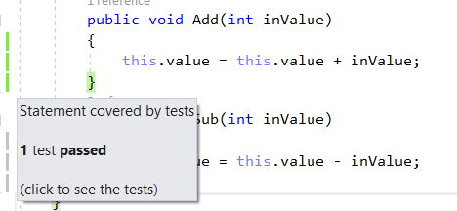
Code coverage
Test
Code coverage
public void AddMethod()
{
var target = new Aggregator();
target.value = 1;
target.Add(2);
Assert.AreEqual(target.value, 3);
}
Notes:
It is for you – show u what is not tested
It is for estimation

Slide 5
Code coverage
Test
Code coverage
public void AddMethod()
{
var target = new Aggregator();
target.value = 1;
target.Add(2);
//Assert.AreEqual(target.value, 3);
}
Notes:
disadvantages

Slide 6
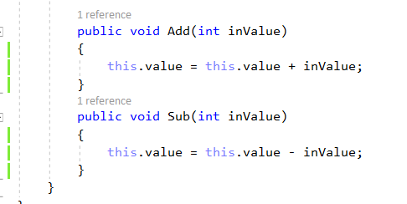
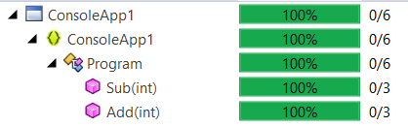
Code coverage
Notes:
disadvantages

Slide 7
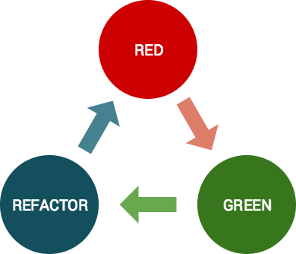
Test-driven development

Slide 8

Mutant
Code
public void Add(int inValue)
{
value = value + inValue;
}
public void Add(int inValue)
{
}
Code coverage
Notes:
What is WC (vs kendo)

Slide 9
Mutant
Code
public void Add(int inValue)
{
value = value + inValue;
}
public void Add(int inValue)
{
}
Bad test
//Assert.AreEqual(target.value, 3);
Good test
Assert.AreEqual(target.value, 3);
Notes:
What is WC (vs kendo)

Slide 10
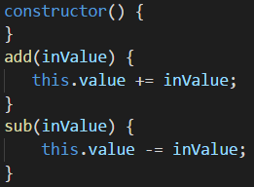
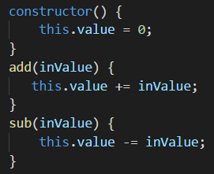
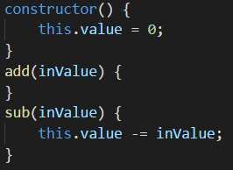
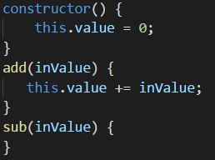
Mutants
Notes:
Let’s create mutant rule

Slide 11
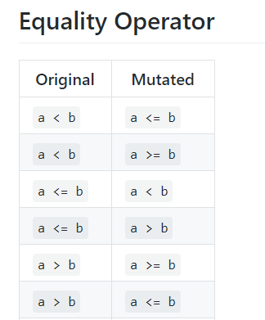
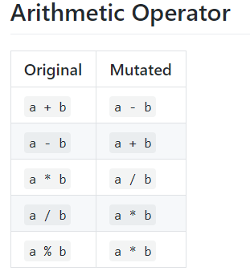
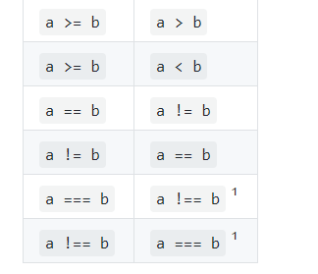
Mutations
Notes:
Let’s create all possible mutants – example

Slide 12
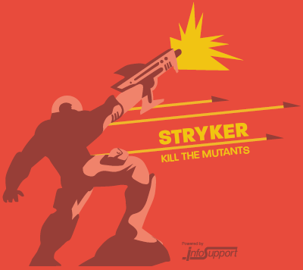
Mutations
Block Statement
Arithmetic Operator
Array Declaration
Boolean Literal
Checked Statement
Conditional Expression
Equality Operator
Logical Operator
String Literal
Unary Operator
Update Operator
https://github.com/stryker-mutator
Notes:
Let’s create all possible mutants – example

Slide 13
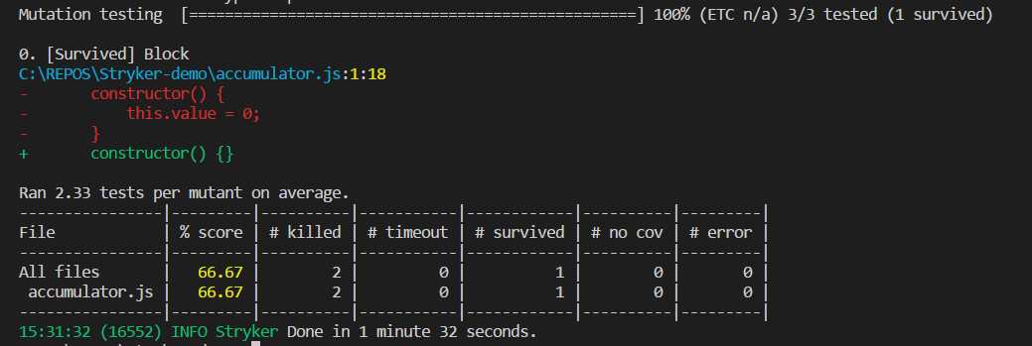
Mutant killing
Notes:
What is WC (vs kendo)

Slide 14
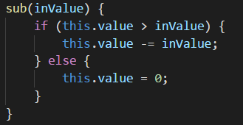

Equal mutant
Code
Stryker output
Notes:
What is WC (vs kendo)

Slide 15
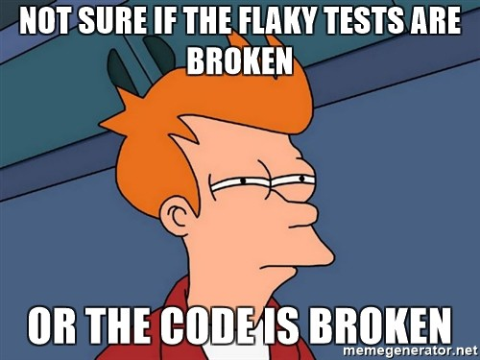
Flaky tests
Notes:
What is WC (vs kendo)

Slide 16
Bad mutants
Looping
Memory gluttony
Memory leak
System calls
Environment crash
Notes:
What is WC (vs kendo)

Slide 17

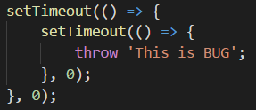
Jasmine/Karma fails
Notes:
What is WC (vs kendo)

Slide 18
Mutant testing complexity
N² ?
Independent for classes
Clear code restriction
Test coverage analyze
Notes:
What is WC (vs kendo)

Slide 19
Parallelization of Mutant killings
By class
By mutants
By methods
Incrementation testing
Notes:
What is WC (vs kendo)

Slide 20
Mutant testing advantages and disadvantages
Hard tested code
Show true untested code
Force to write code smarter
Hard to test code
Hard to change code
“Score” is not objective
Can be unstable
Notes:
What is WC (vs kendo)

Slide 21


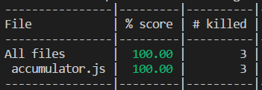
Mutant tests can generate code?
Code
Tests
Notes:
What is WC (vs kendo)

Slide 22
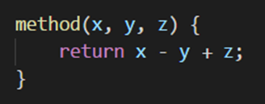
Mutant tests can generate code?
Code
Tests
Notes:
What is WC (vs kendo)

Slide 23

Mutation level
Level 0
Level 1
Level 2
Notes:
What is WC (vs kendo)

Slide 24
Whole level mutation testing
Level 1
Level 2
Level N
Code
mutation
quantity
N
~N²
…
~2^{N}
Test quantity
increase
x2
1..2?
…
0
Test lines
quantity
increase
x4
?
…
0
Notes:
What is WC (vs kendo)

Slide 25

Whole level mutation tests can generate code?
Notes:
What is WC (vs kendo)

Slide 26
Whole level mutation tests can generate code?
Notes:
What is WC (vs kendo)

Slide 27
Questions?
Unit testing
Code coverage
TDD
Mutation test
How to use it
Problems of Mutation testing
Complexity
Next level of testing

